Slide 1
Sprint 2

Slide 2
Main goals
1, Calendar(home page):
Activity schedules for future events(allow users to add new schedule or remove finished assignments).
Contain 2 page including views in format_month and format_day.
2, Notification( information box or alert function):
Server could send remind message(before the planned event) and certification message(after events) to keep track of users’ progress.
3, Real Activity History Display(history page):
A program working on the local computer monitoring the computer activity and send the info to the server.
Display a dashboard to chart of history time management compare with previous plan.

Slide 3
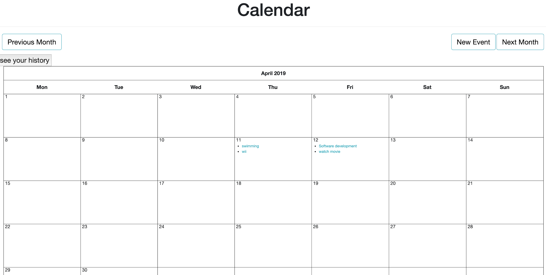
Calendar page

Slide 4
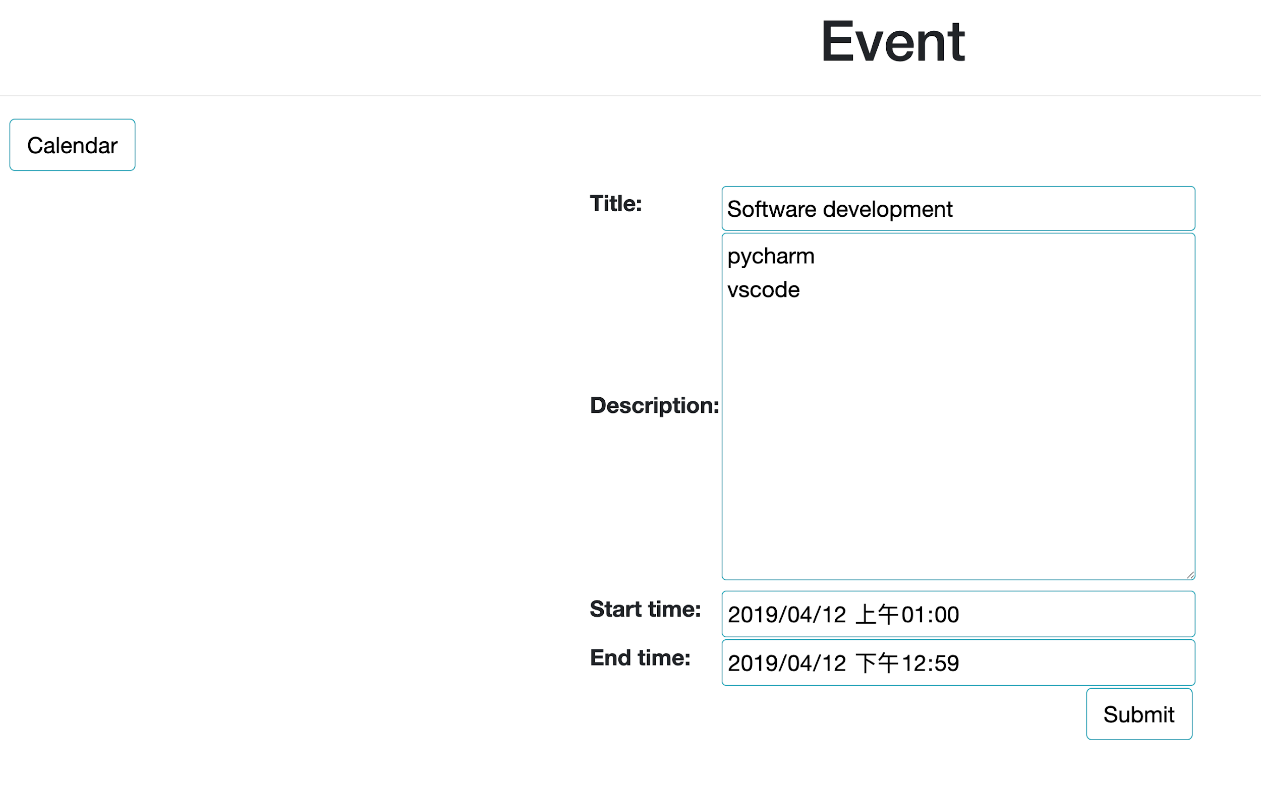
Event arrangement page

Slide 5
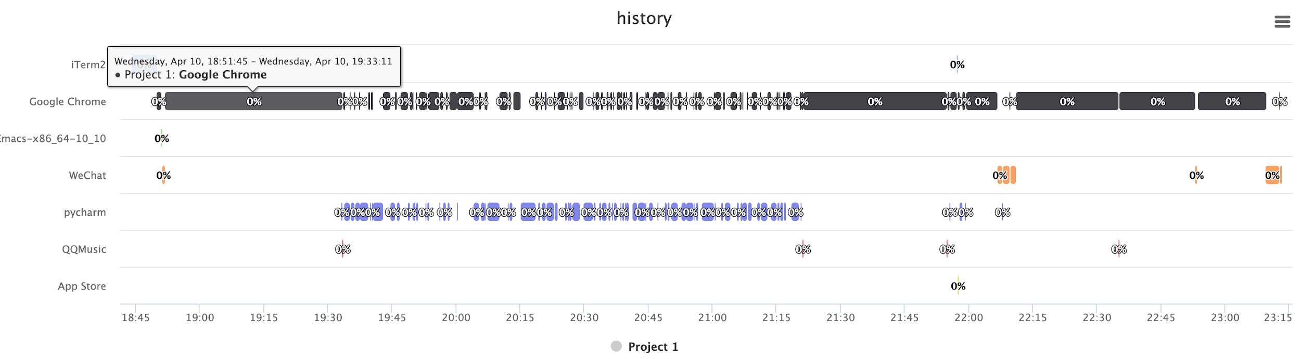
History page

Slide 6
Data model implementation
bio_text
profile
picture
User
name
event
start_time
type
end-time
monitored_activity
type
popularity
name
start_time
end_time

Slide 7
Second Sprint Backlog
1, notification
2,daily event view page
3,comparison graph for history and previous plan.
4,monitoring local network usage

